Slide 1
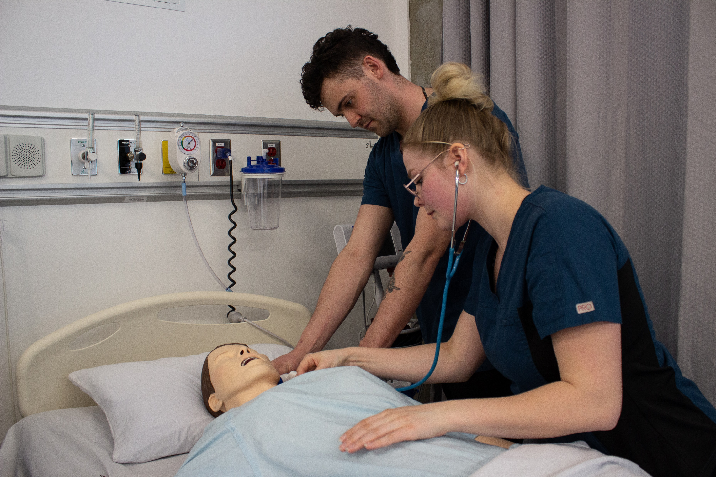
Practical Nursing (PN) program
Information Session
WWW.CAMOSUN.CA
VICTORIA, BC, CANADA

Slide 2

Territorial Acknowledgement
Camosun College is located in beautiful Victoria, British Columbia with campuses on the Traditional Territories of the Lekwungen and W̱SÁNEĆ peoples. We acknowledge their welcome and graciousness to the students who seek knowledge here.

Slide 3
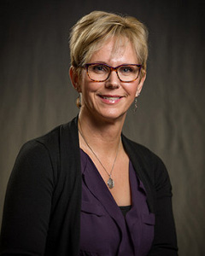
Chair’s Welcome
We, the faculty and staff of the Continuing Care department welcome you! By choosing one of our programs you are demonstrating that you care about your community and that you have an interest and commitment to working with people. During the course of your studies we will partner with you to strengthen your knowledge, skills and values in preparation for your chosen career.
We are delighted that you are considering the Practical Nursing program as your area of study and will take great pleasure in getting to know you, while we work and learn together. We hope you enjoy your experience with us, and wish you success in all that you do!
Ros Giles-Pereira,
Chair, Continuing Care Department

Slide 4

COVID-19
The health and wellbeing of students and staff remains the priority of Camosun College.
Camosun College continues to monitor latest information, work on transition plans and keep the college community safe.
The college is following the guidance and recommendations from B.C.’s Provincial Health Officer, the B.C. Government, WorkSafeBC and Island Health to ensure the health and wellbeing of students, employees and campus visitors.
COVID-19 information and frequent updates are available at: Camosun.ca/COVID19

Slide 5

CASN Accredited Program
Camosun's PN program has fulfilled the necessary requirements for recognition by the Canadian Association of Schools of Nursing (CASN) Accreditation.
The PN program is accredited from January 2022 to January 2029.
http://accred.casn.ca/our-programs/bscn-program/accredited-programs/

Slide 6



What does an LPN do?
How much does an LPN earn?
How do I get into the program?

Slide 7
What does an LPN do?
Provide direct nursing care
(assessments of patients, treatments, administration of medications, etc.)
The program prepares graduates with the knowledge, abilities and skills to work with clients of all ages in need of professional nursing care.
LPNS work in many settings:
  Complex care (long term care)
  Acute care
  Group homes
  Home Support (case management)
  Home nursing care / community care
LPN starting wage is approximately $31 - 41/hour if unionized and $28 –$36/hour if non-unionized.
Notes:
Wage grid – BCNU April 1, 2023

Slide 8



Requisite Skills and Abilities
https://www.bccnm.ca/Documents/competencies_requisite_skills/LPN_requisite_skills_abilities.pdf
Use this document to help determine your ability to meet the demands for a career as a licensed practical nurse in Canada.

Slide 9
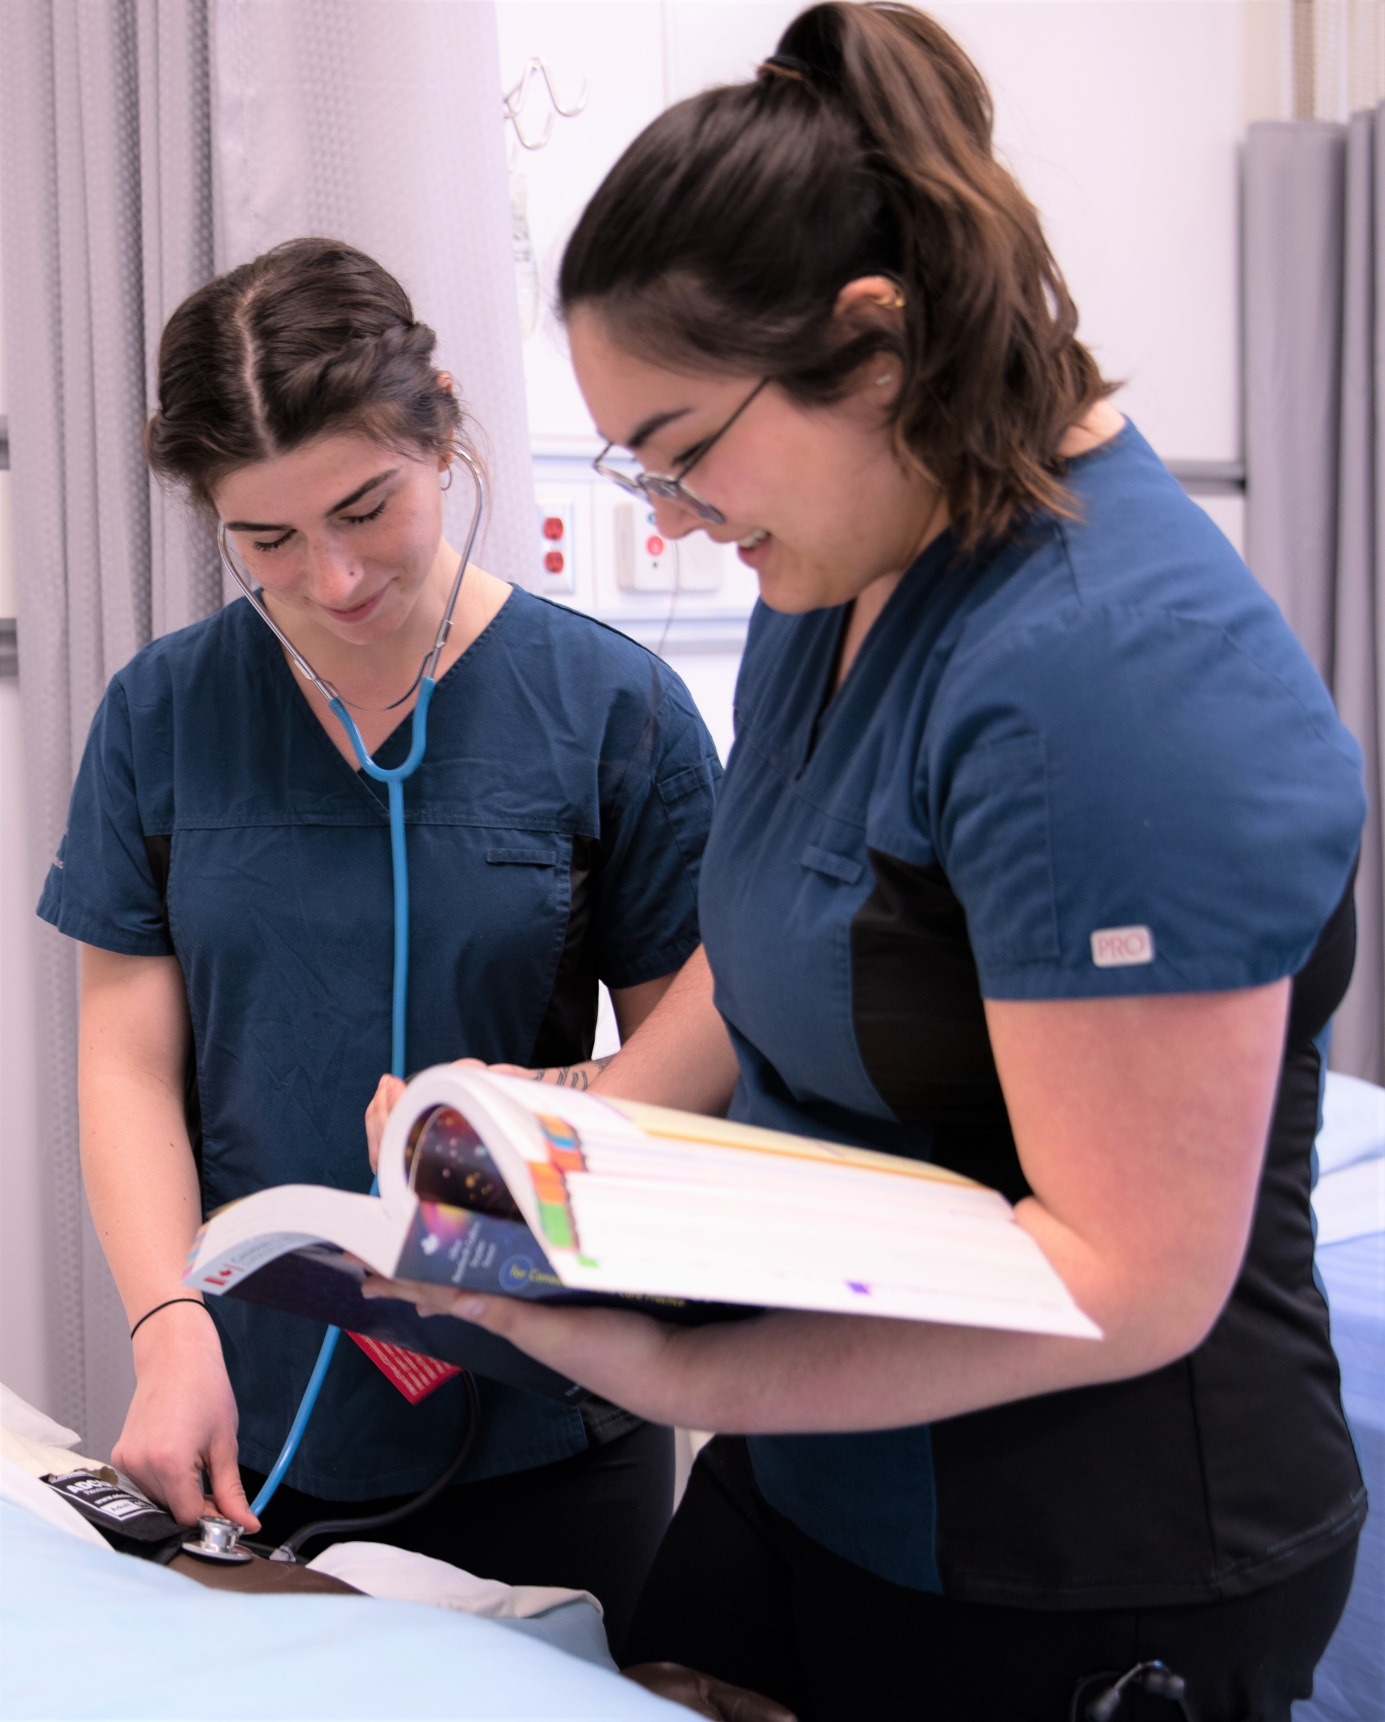

Slide 10
Practical Nursing Program
Start: September
1 intake per year
Length: 20 months long
(straight through with short breaks)
Schedule: Monday to Friday daytime
Clinical: 4 Clinical Placements + Preceptorship
(placements can be day or evening shifts)

Slide 11
PN Admission Requirements
C+ in English 12
C in Math 11
(Pre-calculus 11 or Principles of Math 11 or Applications of Math 12)
C+ in PNUR 101
(Human Anatomy and Physiology for PN) or equivalent
(C or higher in Biology 12 is a pre-requisite for PNUR 101)
Grade 12 Graduation or equivalent
See PN website for alternative courses:
http://camosun.ca/learn/programs/practical-nursing/how-to-apply/
WWW.CAMOSUN.CA VICTORIA, BC, CANADA

Slide 12
Application Process
The application window is from late September-August 31 each year.
The PN program is a Limited Enrolment program which is
a program with a defined limit on the number of students accepted to the program. In many cases, enrolment is cohort-based, and courses are only available to those students enrolled within the program. When there are more qualified applicants than seats, a waitlist is typically created. Also referred to as a ‘Seated Program’.
Waitlisting
Program is still accepting applications however successful applicants will be placed on a waitlist. Offers of Admission will be issued as space becomes available in the program. Applicants who do not receive an offer, will be required to reapply.

Slide 13
Submit an application online through Education Planner BC and pay the $46.18 application fee.
All prerequisites need to be submitted.
The first 32 fully qualified applicants are offered a seat. A $175.00 non-refundable deposit is required when offered a seat. This money will then go towards your first semester tuition.
If for any reason you change your mind after you have accepted a seat, PLEASE phone Registration and let them know immediately. There are always students waiting for a seat that would appreciate advance notice that they have a seat in the program.

Slide 14
Estimated PN Program Costs
Tuition (domestic students): ………………………………………………………….. $16, 127
Student Fees: ………………………………………………………………………………. $750
Application Fees: …………………………………………………………………………. $46.18
Approximate additional program costs
Textbooks: …………………………………………………………………………………… $1,500
Instruments (Stethoscope, pen light, nursing watch, BP cuff): …….. $200
Uniforms (Standardized uniforms, nursing shoes, ID badge): ………. $450
Other (Criminal Record Check, Basic Life Support,
Standard First Aid/BLS, TB Test, N95 mask fit testing, Violence Prevention classroom training):………………………………………………………………………………… $400
Expendable Supplies (pens, binders, memory sticks, paper, etc.)
                IMPORTANT: Costs shown above are estimated only and tuition estimates may not reflect up-to-date tuition costing. Students are encouraged to visit the program website for current tuition costing information.

Slide 15
On Completion of the Program
All students must write and pass the REx-PN; the Regulatory Exam-- Practical Nurse
This is an entry-to-practice exam for applicants who want to become LPNs in BC; also allows these LPNs to work across Canada
CAT-style exam with no limit to the number of times a graduate may write however applicants must wait 60 days between attempts
You may be eligible f​or provisional registration, which allows you to work as an LPN(p) while you are waiting to write the exam
Cost to register for and write the REx-PN is $350 + GST per attempt; annual licensure = $671.60 (2024)
WWW.CAMOSUN.CA VICTORIA, BC, CANADA

Slide 16
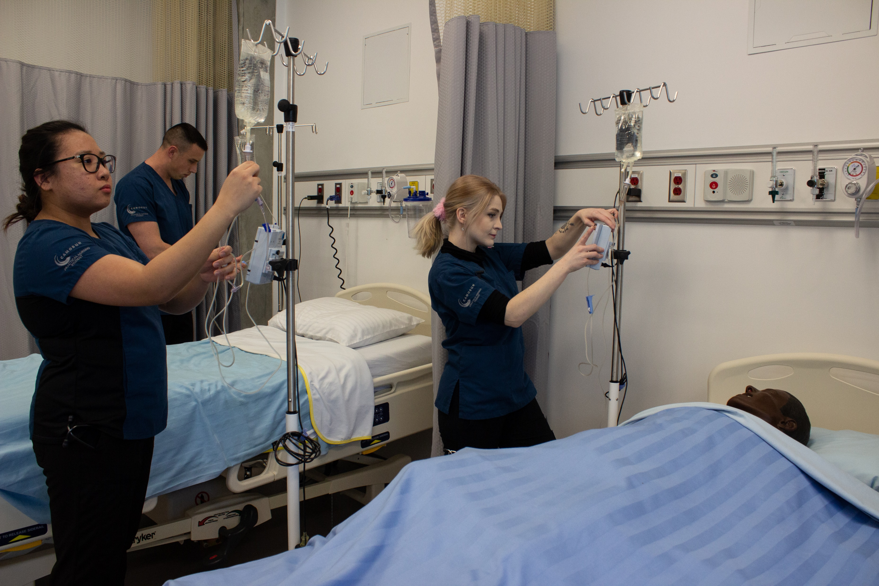
Who Are Our Students?
Recent high school graduates
Mature students changing career
Men and women
People with health education
  from other countries

Slide 17
What Helps Students Be Successful?
Have support from family and friends.
Devote approximately 15 to 30 hours each week to study, laboratory practice and assignments.
Attend classes regularly.
Achieve a balance between home and school life.
Have daycare and alternatives set up for children (remember practicum shifts can start early or end late and may also require travel).
Have good physical health (you need to have good mobility, stamina and skin integrity).
Connect early with Centre for Accessible Learning (if applicable).

Slide 18
Why Choose Camosun?
Experienced & highly qualified faculty (all faculty are Registered Nurses/teaching faculty have a minimum Bachelor of Science in Nursing)
Well established Nursing Lab (set up with the same supplies and equipment used in health care facilities)
Camosun College Support Services (counselling, learning skills, writing centre, centre for accessible learning, library, computer labs, career resource centre, financial aid, ombudsman, etc.)
Camosun College Fitness Centre (free for students)
Our graduates have very high employment rates after graduation
Brand-new Health & Wellness building with state of the art nursing lab.

Slide 19
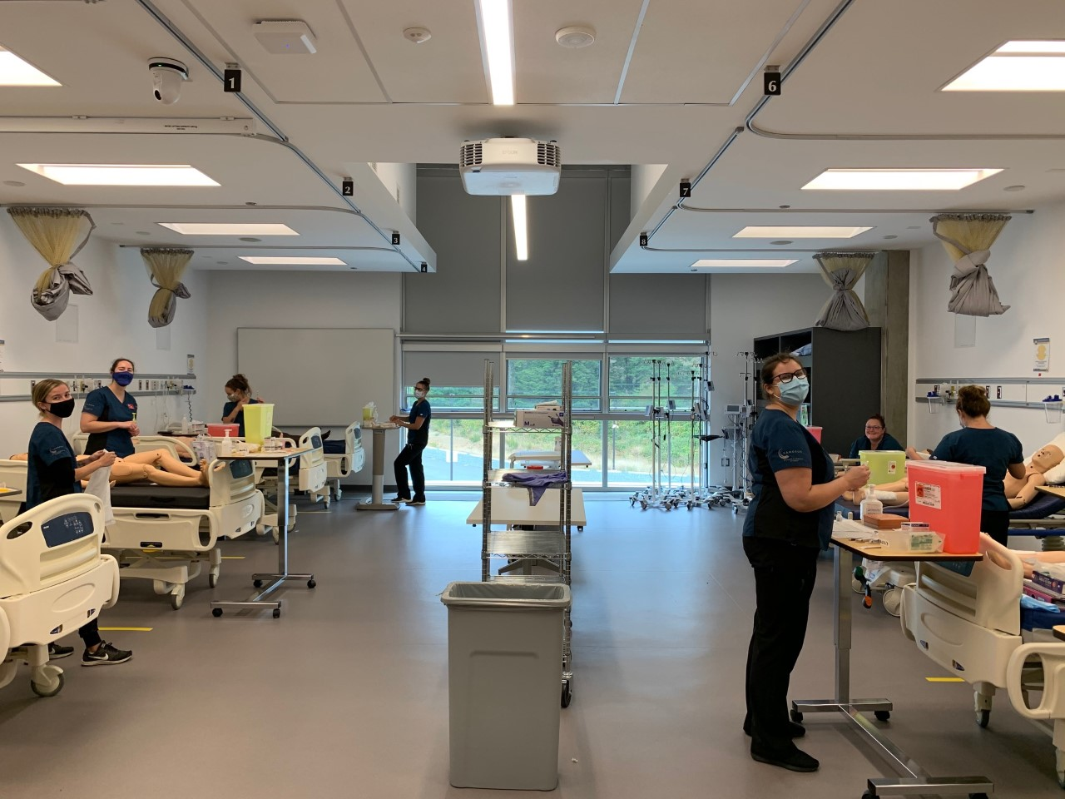
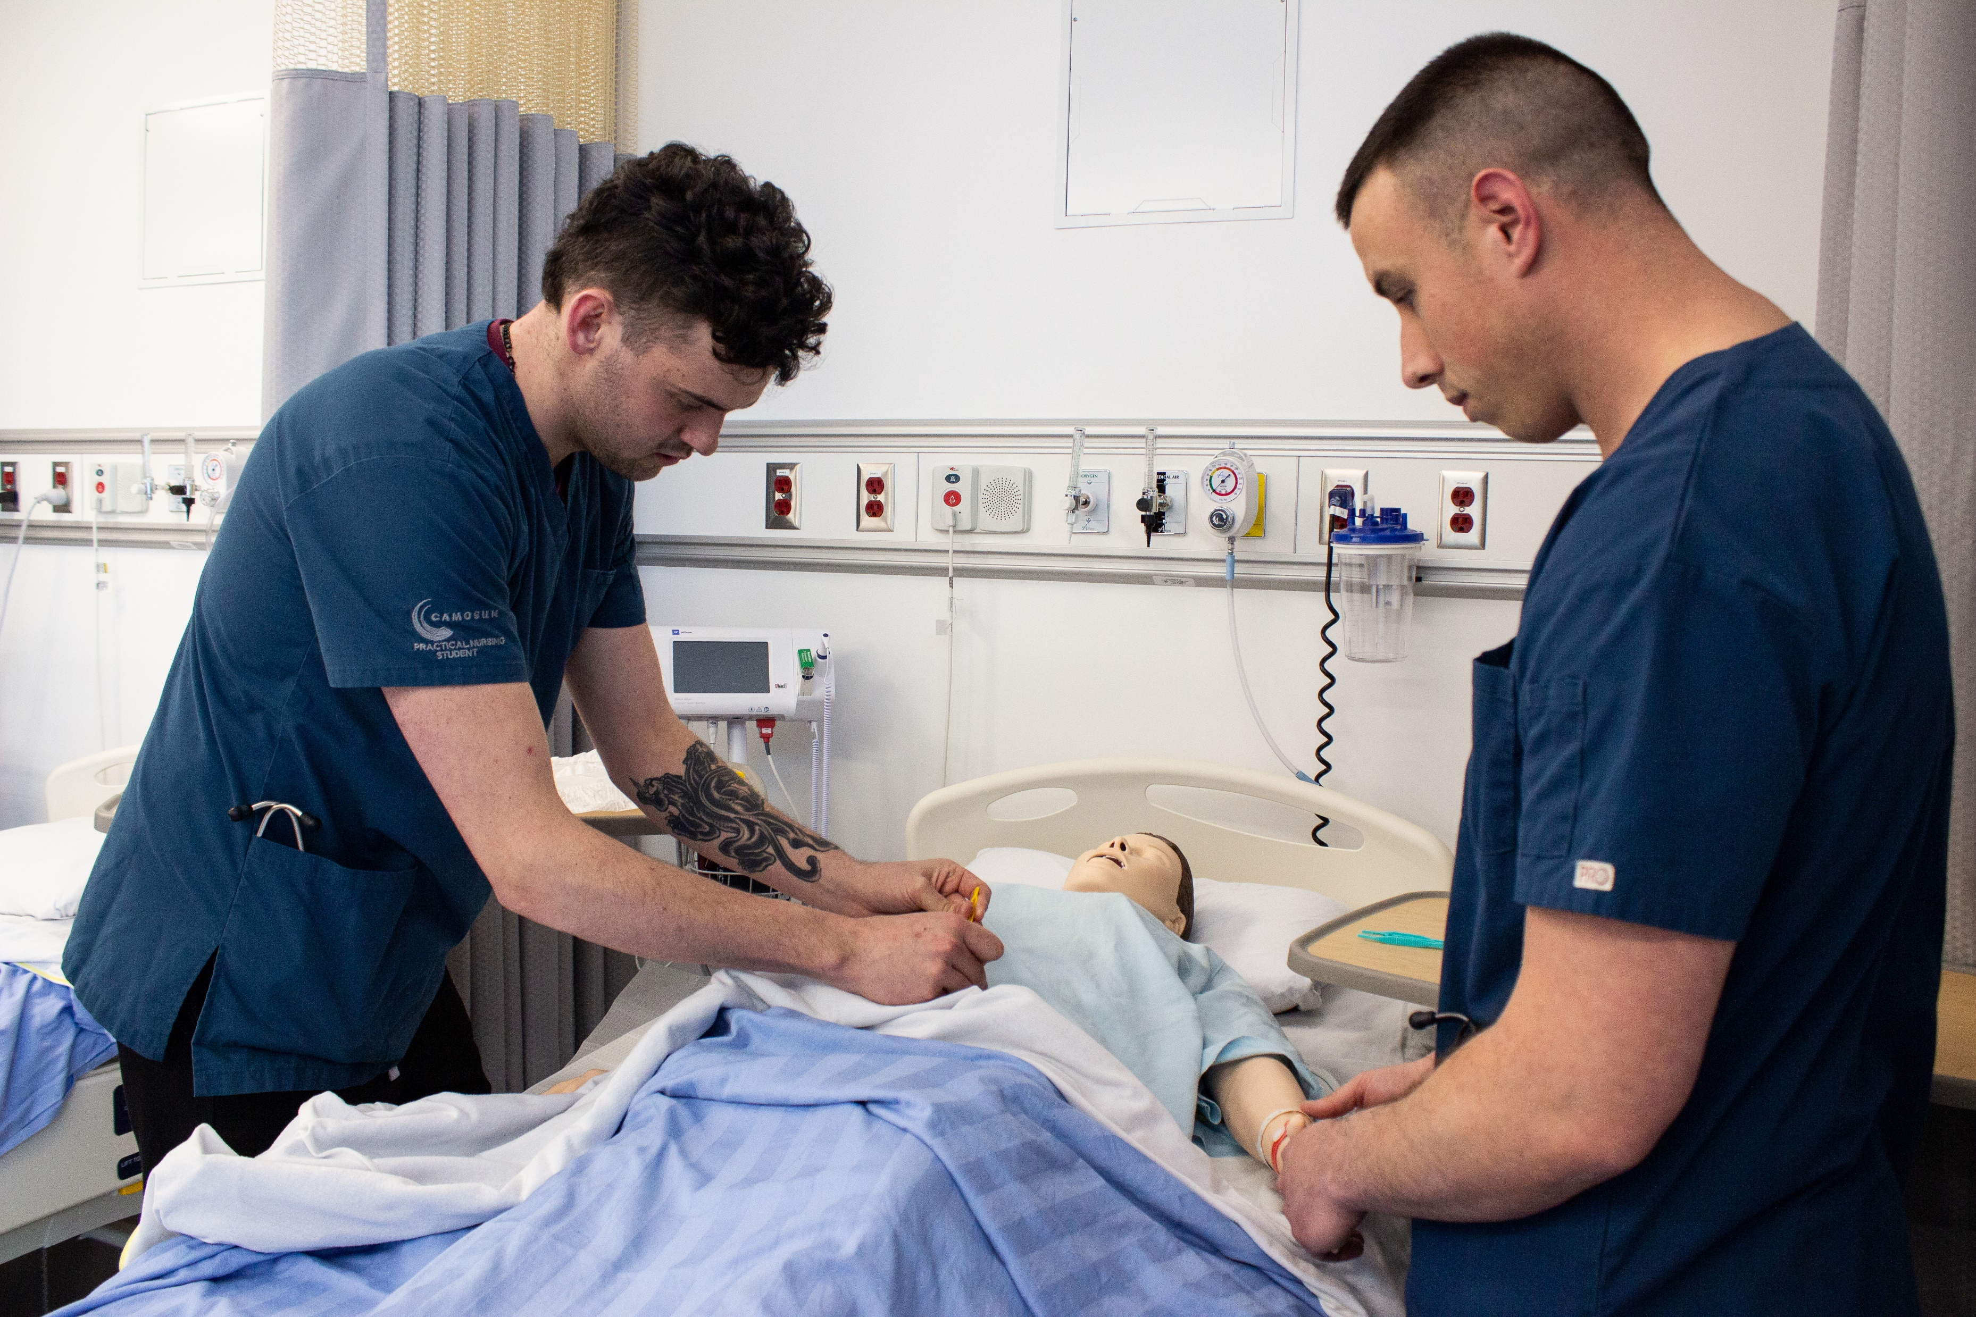

Slide 20
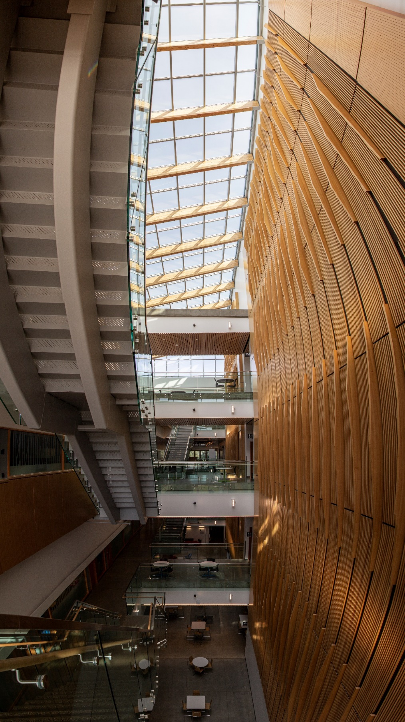
Camosun College
Camosun College is B.C.’s largest public college
19,000+ students
1,200+ faculty and staff
Programs range from arts and business to tech and trades to university transfer and continuing education
Credentials include dual credits, certificates, diplomas, degrees, post-degree diplomas

Slide 21
School of Health & Human Services (HHS)
Camosun College offers more than 15 health and human services programs, including degrees, post-degree diplomas, certificates, diplomas and university transfer courses.
Our School, the School of HHS is a place of warmth and caring.
Our goal is to educate and support “flourishing Individuals, families and communities”.

Slide 22
Centre for Health and Wellness (CHW)
All HHS Programs except Dental are delivered at the CHW at Interurban Campus
The CHW brings together HHS Programs and allows a more interdisciplinary approach to teaching and learning
The CHW provides twenty-first century learning environments including modern classrooms designed to foster active learning, hands-on labs, high technology simulation environments, and lots of collaboration spaces

Slide 23
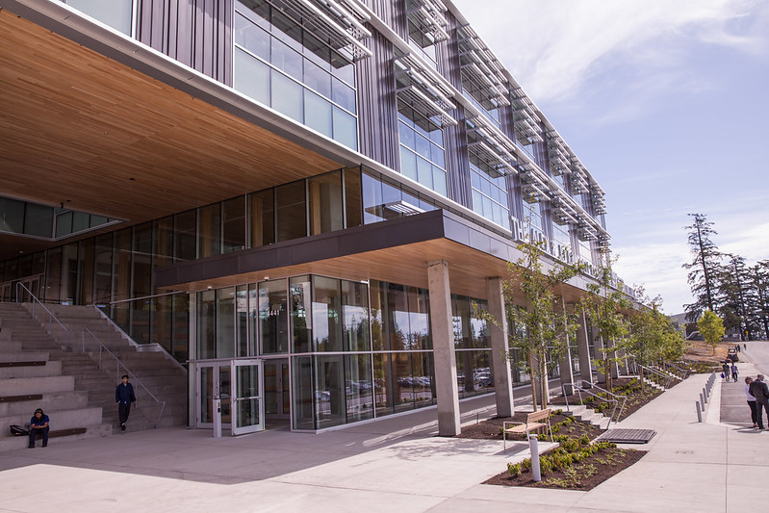
Alex & Jo Campbell Centre for Health and Wellness
21st century education for outstanding health and wellness professionals
$63.8 million investment
89,000 sq. ft. facility at Interurban campus
800+ students
Latest in health education teaching
Interdisciplinary approach is aligned with Island Health

Slide 24
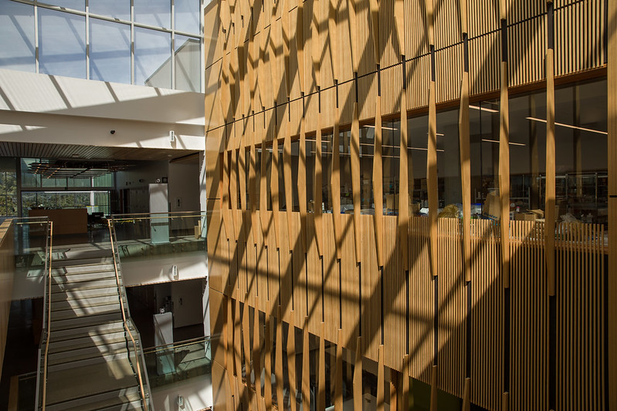
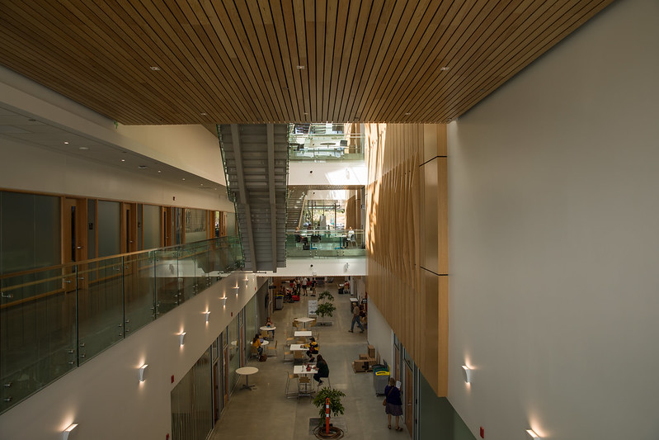
Alex & Jo Campbell Centre for Health and Wellness
21st century education for outstanding health and wellness professionals

Slide 25

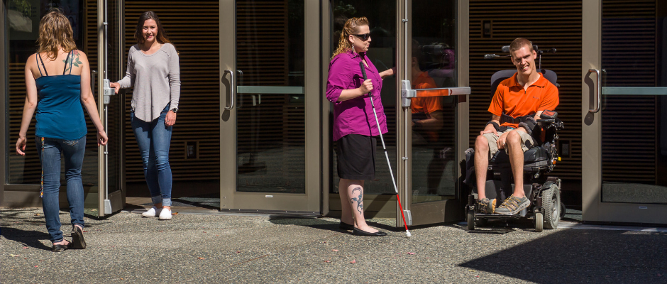

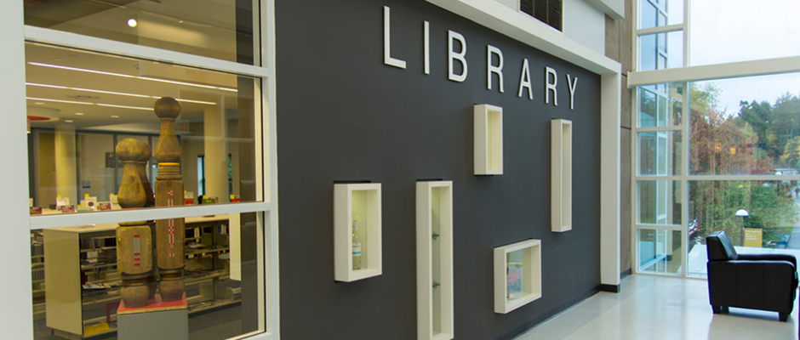



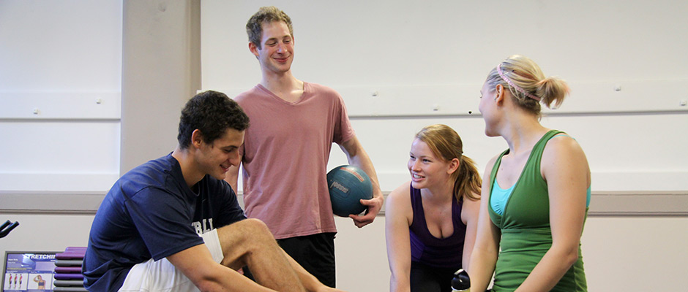




Student Services at Camosun
Admissions & Recruitment
The right start at Camosun
The Writing Centres
How can we help?
Centre for Accessible Learning
Supporting your learning experience
Academic Advising
Guiding you on your educational journey
Academic Upgrading
Whatever your need, we have an option for you
Indigenous Student Support
Find your way and feel like you belong – with our help
Fitness & Recreation
Make time for your well-being
Financial Aid & Awards
Funding your education
Counselling Centre
Supporting you through life’s challenges

Slide 26

Indigenous Support Coordinator
Artemis Fire is Red River Métis and grateful to be a visitor on the unsurrendered territories of the lək̓ʷəŋən and W̱SÁNEĆ peoples.
Artemis is passionate about walking with people on their journeys.
As the Health and Human Services Indigenous Support Coordinator, Artemis supports students in various ways, including assisting applicants to confirm their Indigenous identity. firea@camosun.bc.ca

Slide 27

Review the Practical Nursing (PN) program pages online
Program Overview
Courses
Costs

Slide 28
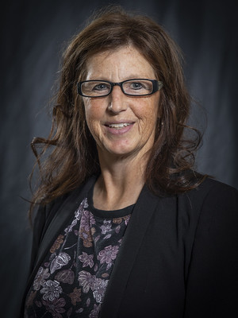

View the Dean’s Welcome and the School of Health & Human Services (HHS)
Student Handbook online
Lori Zehr, EdD MSc
Dean, School of Health and Human Services

Slide 29
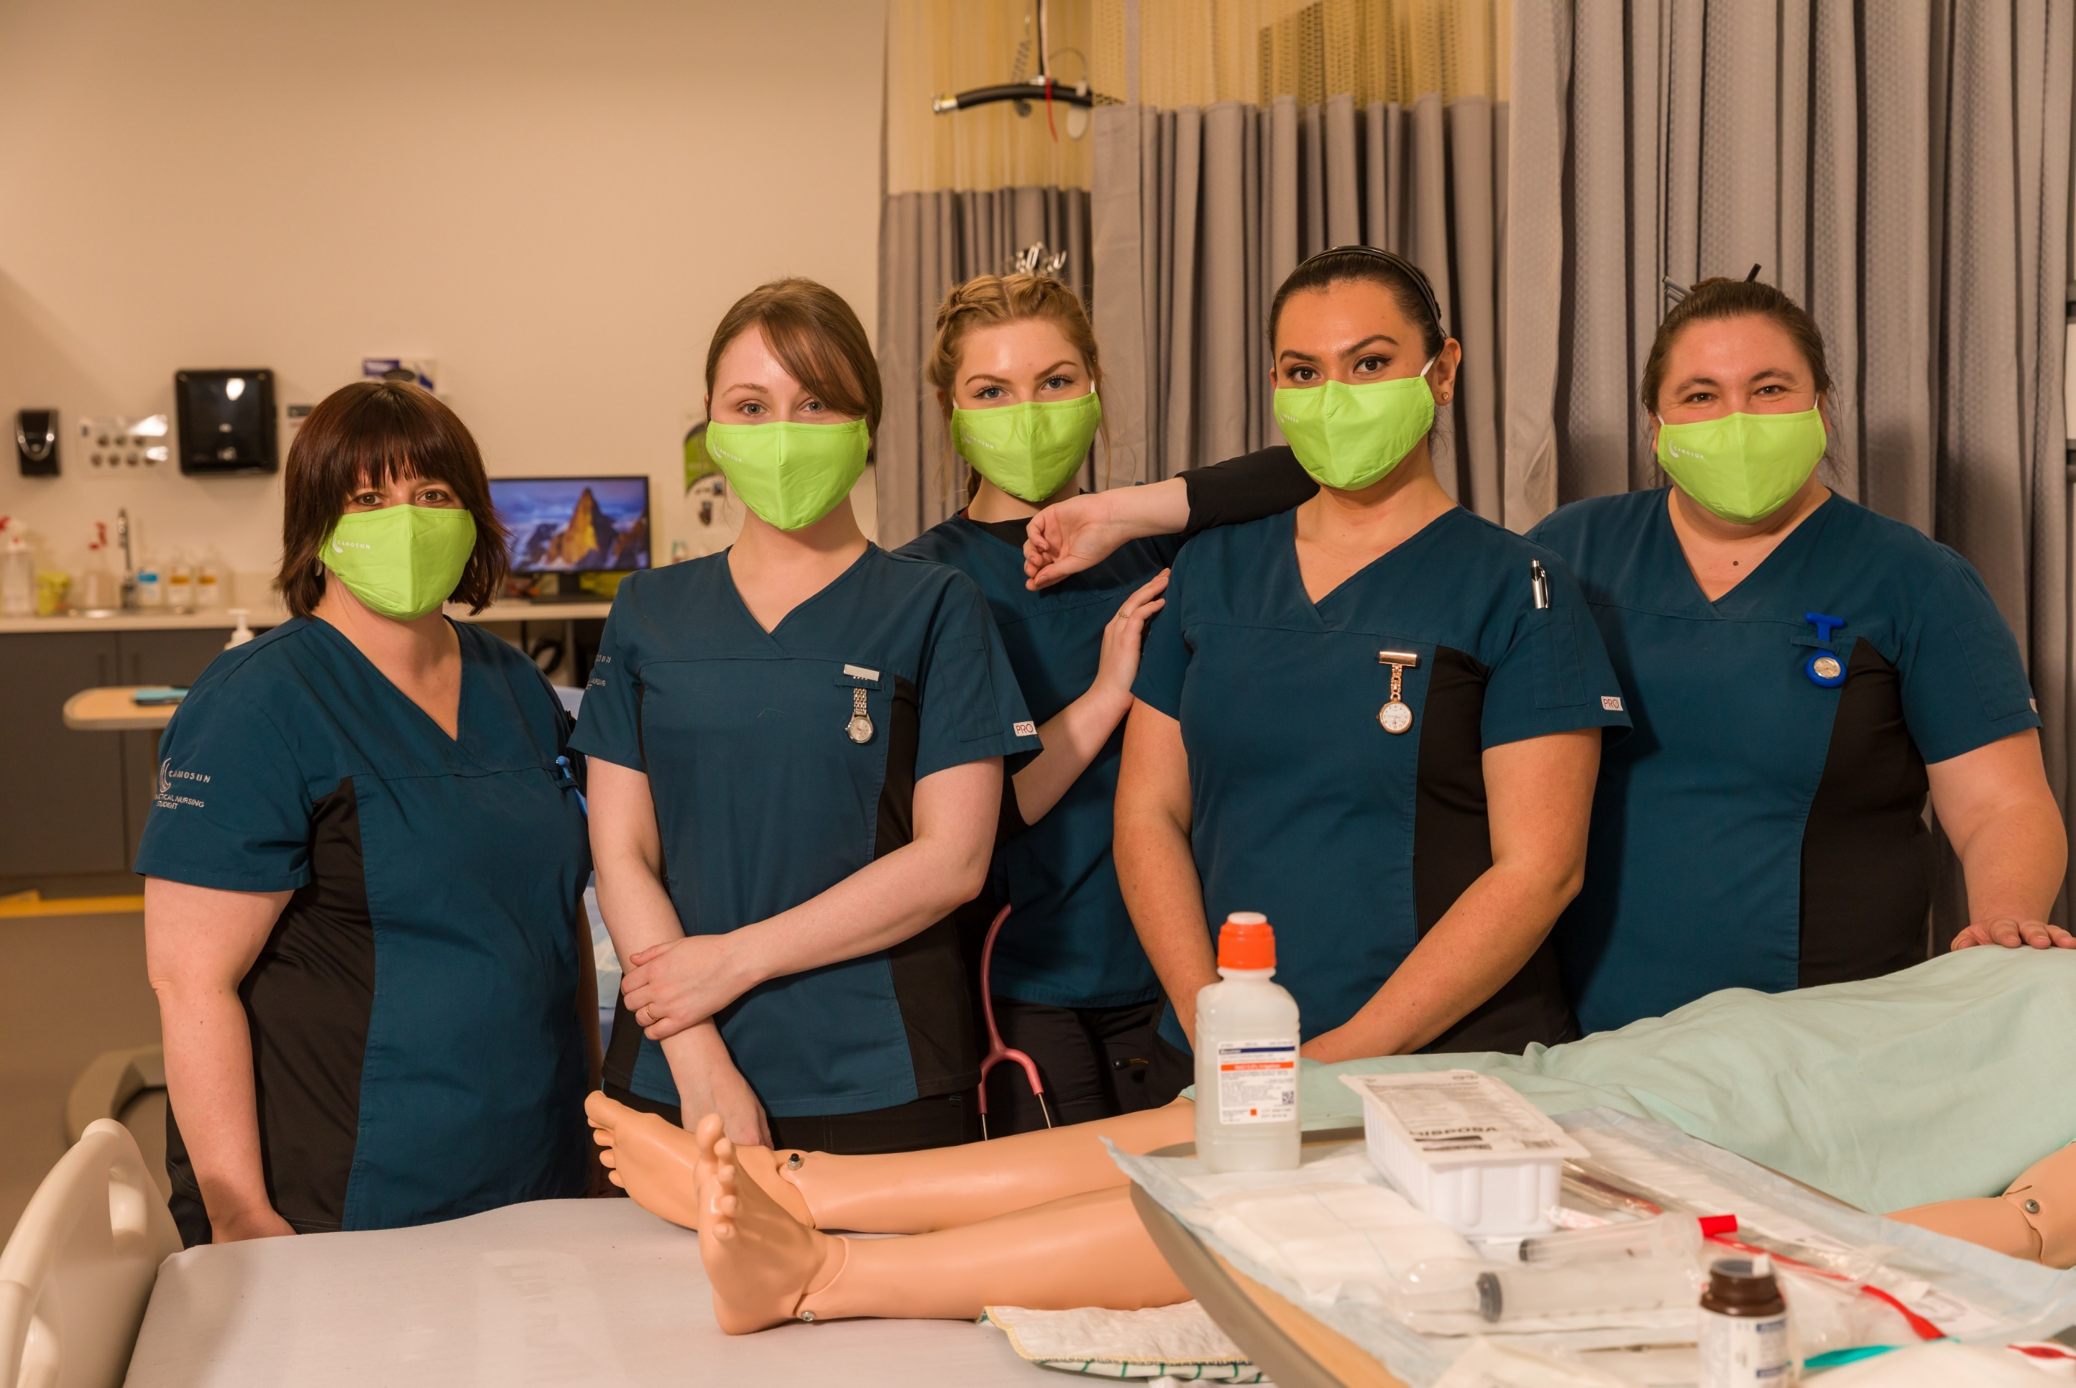

Slide 30
Thank you
We look forward to seeing you soon
Admissions: 250-370-3550
FOR MORE INFORMATION:
General admissions | admissions@Camosun.ca | Phone: 250-370-3550
PN admissions advisor, Cheryl Dyck | cdyck@Camosun.ca | Phone: 250-370-3843
PN Program Lead, Mercedes Schmidt | Schmidtm@Camosun.ca

